Slide 1
Appendix
Introduction to Colab & Basic Python Instructions

Slide 2
Outline
Colab installation & usage
Important Python packages
Flow control：if and for loop

Slide 3
Colab or Google Colab stand for Google Colaboratory ）
Colab is a handy tool (Notebook) for editing and executing Python or R codes on the Google Cloud
You don’t need to install any software except the Google Colab for running your Python codes

Slide 4
Colab is easy to use. The only thing you need to do is to apply for a Google account.
It is free as it is of today (2022/11/5)
Programs are executed on the Google Cloud; You don’t need a powerful computing device to execute your codes. You can use GPUs or TPUs on the Google Cloud to speed up your execution

Slide 5
Components of a Computer
CPU(Central Processing Unit)
RAM(Random Access Memory)
HD(Hard Disk)
Accelerator for computing
GPU (Graphic Processing Unit), used for image processing or numerical computing
TPU(Tensor Processing Unit), Google’s proprietary device for AI and Machine Learning

Slide 6
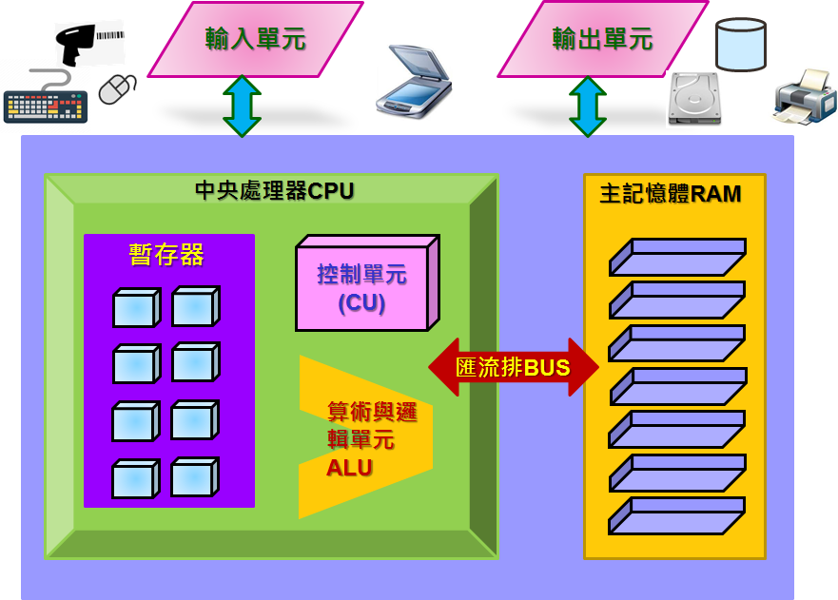


Slide 7


Slide 8
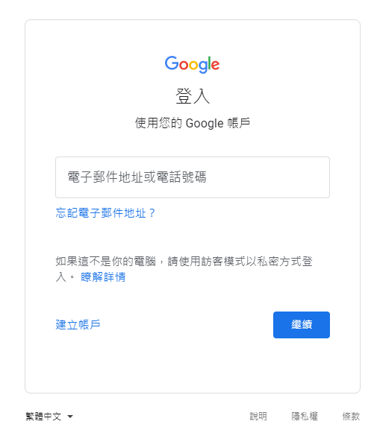

Slide 9
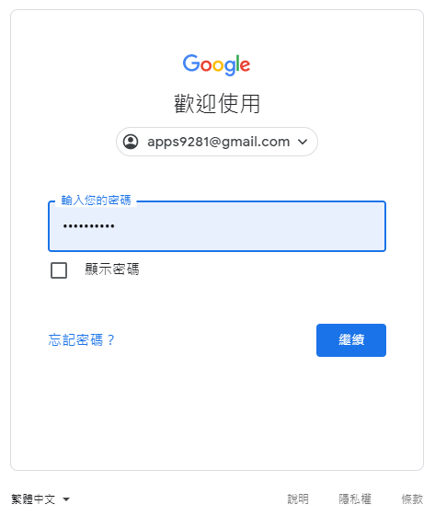

Slide 10


Slide 11
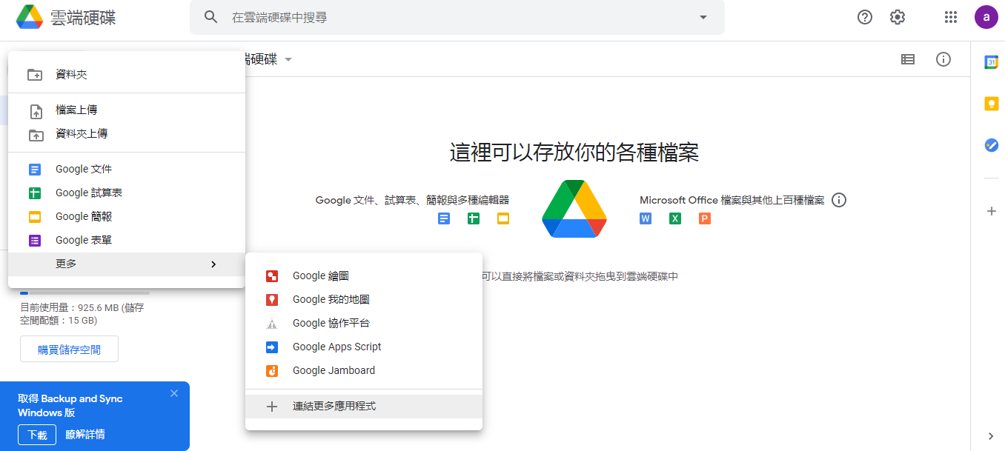
剛開始，此處找不到Colaboratory

Slide 12
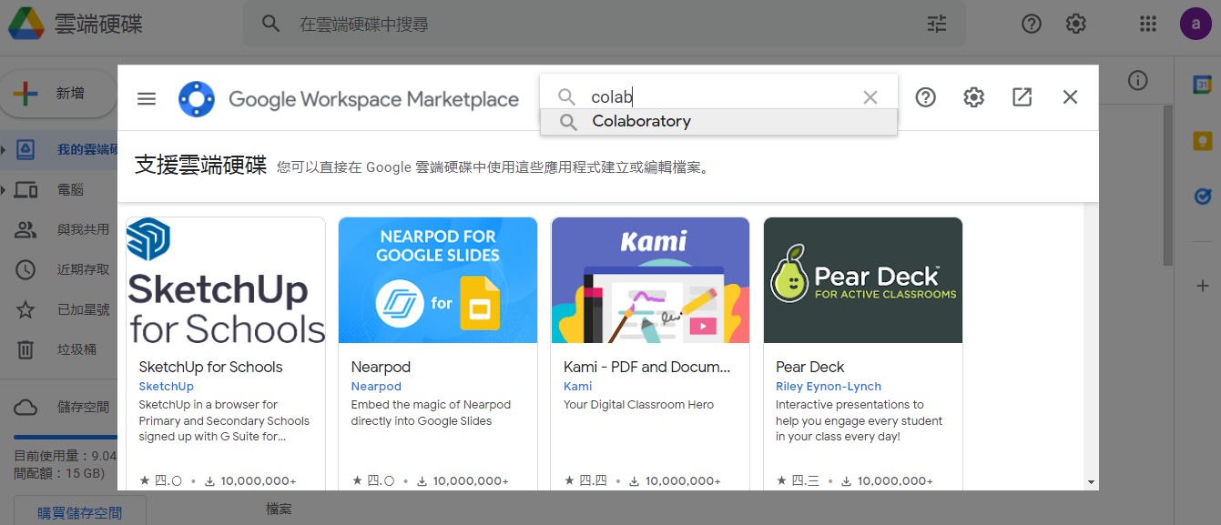

Slide 13
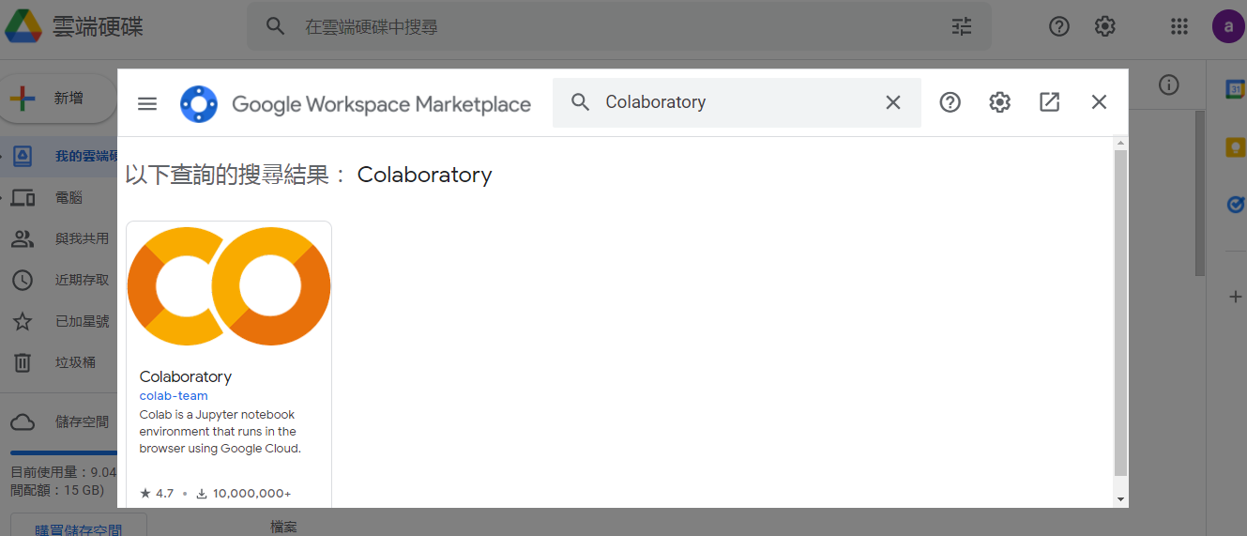
Google的Colaboratory圖示

Slide 14
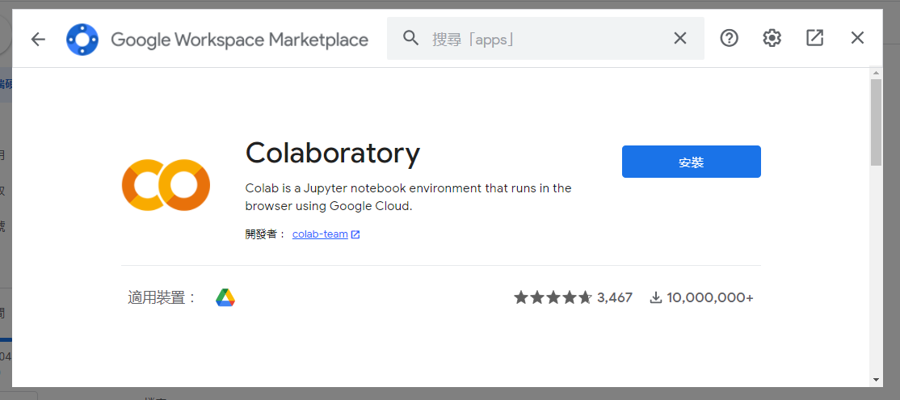

Slide 15
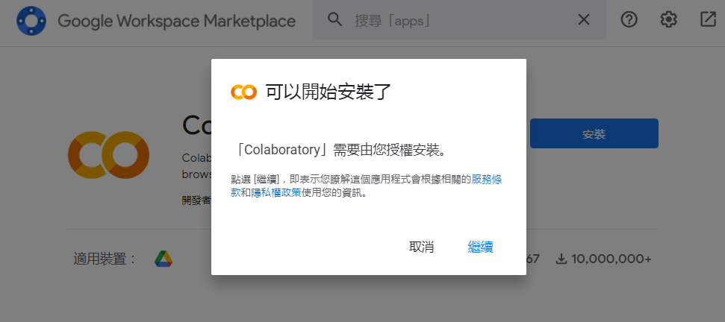

Slide 16
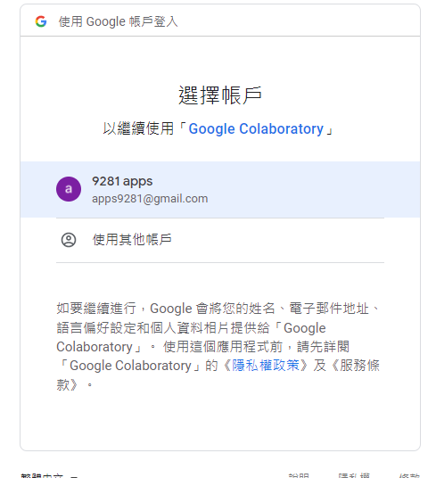
安裝授權的Google帳號

Slide 17
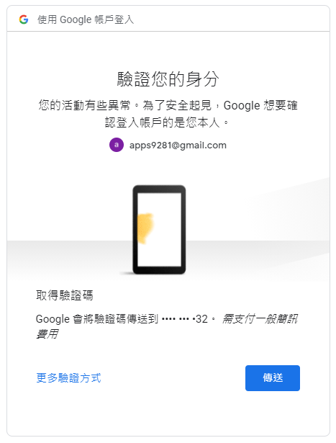

Slide 18
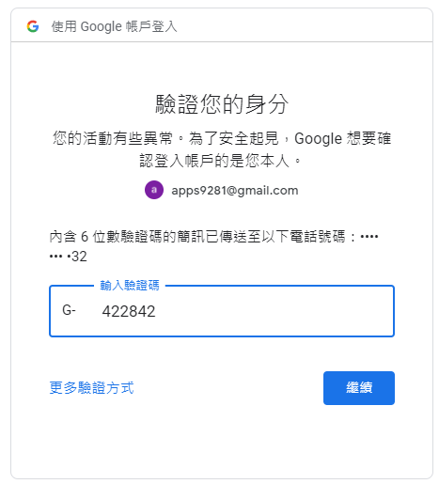

Slide 19
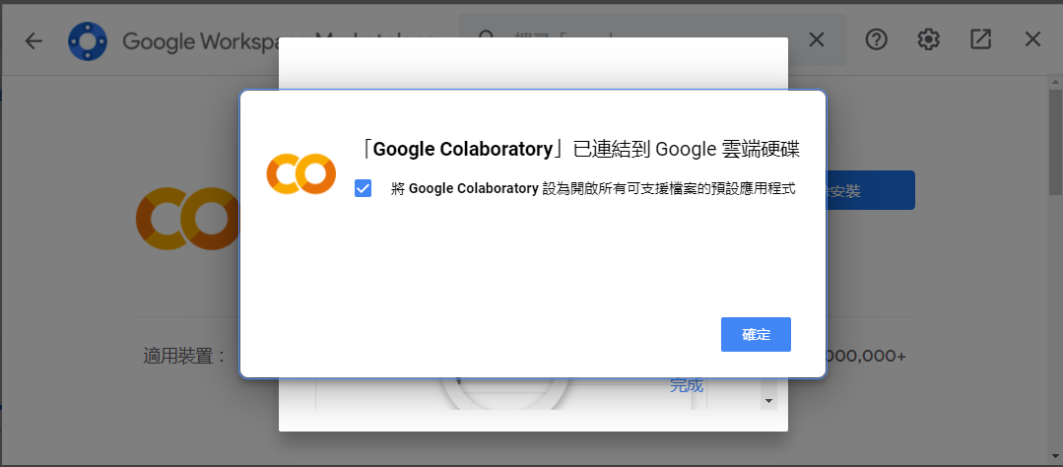

Slide 20
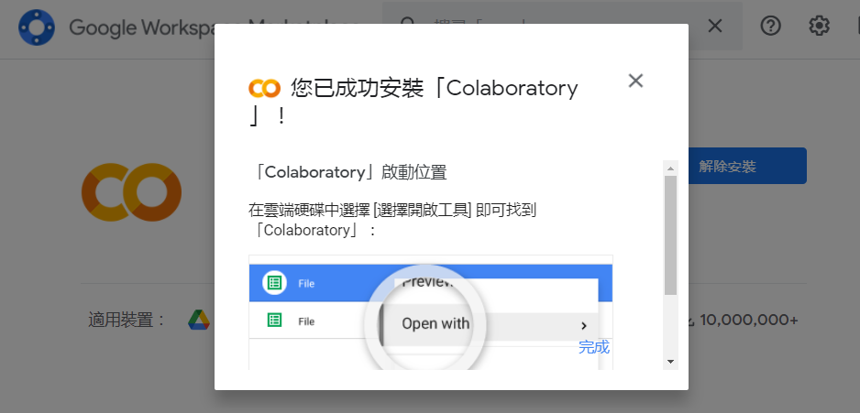

Slide 21
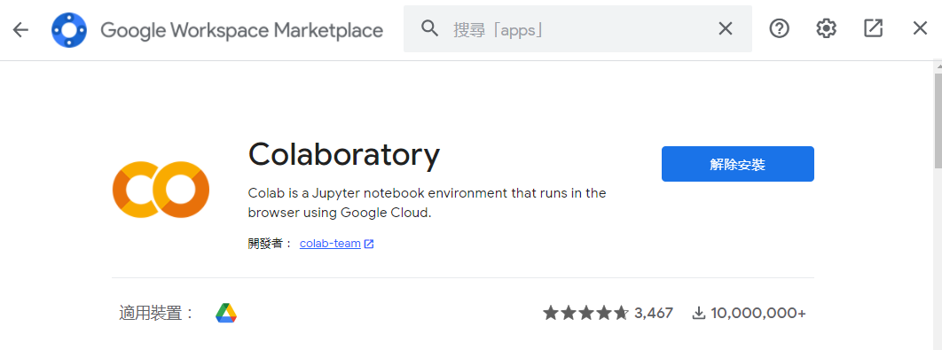

Slide 22
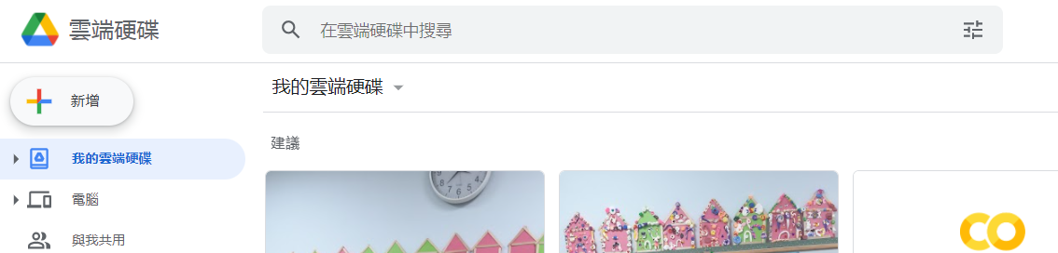

Slide 23
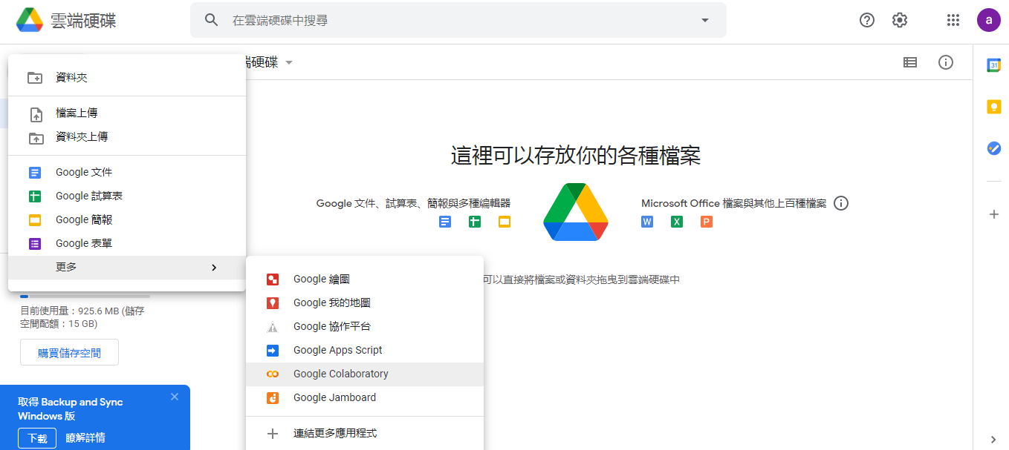

Slide 24
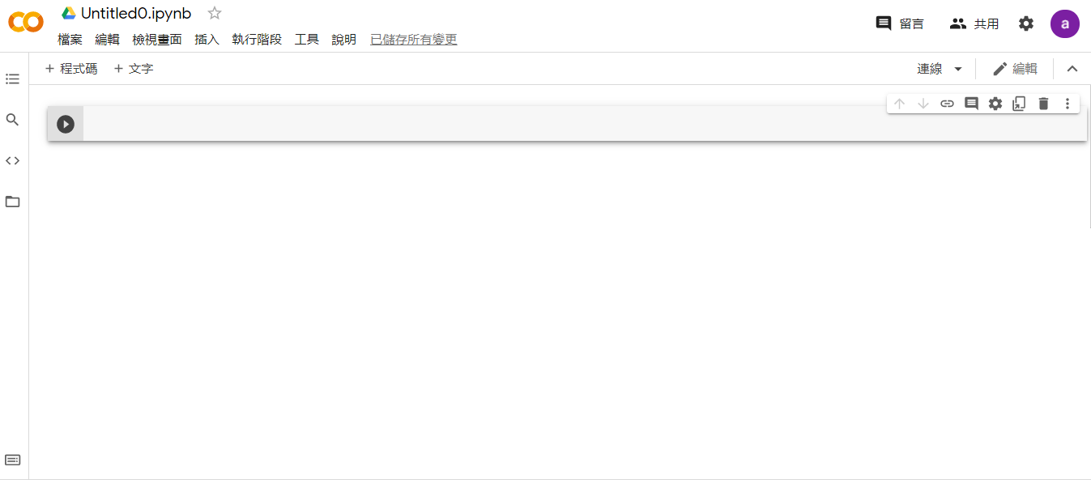
這就是Notebook

Slide 25
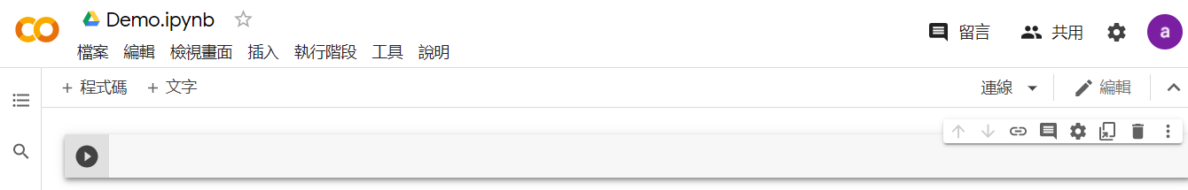

Slide 26
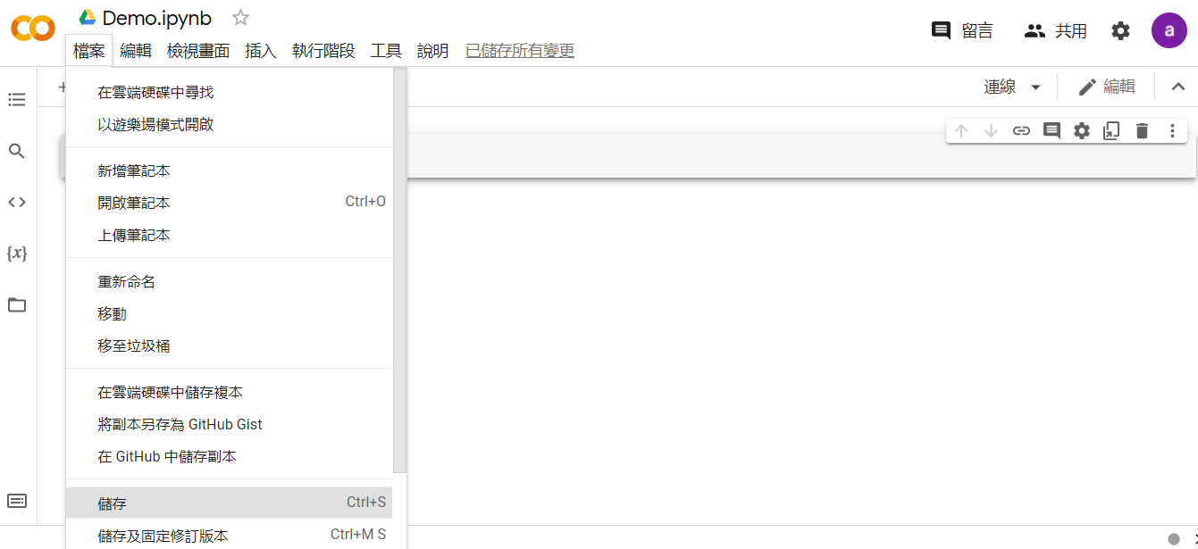

Slide 27
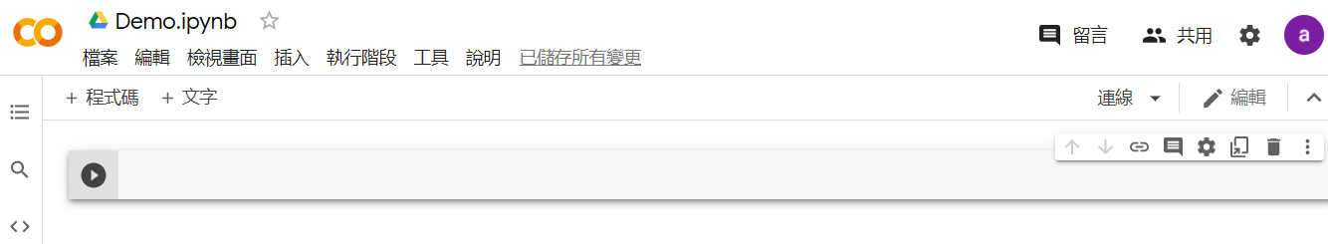
執行
程式碼區塊

Slide 28
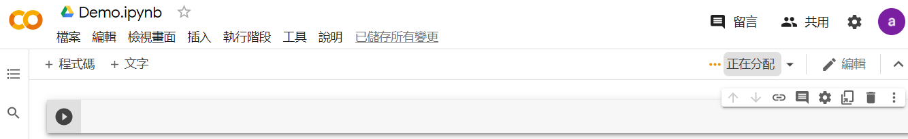
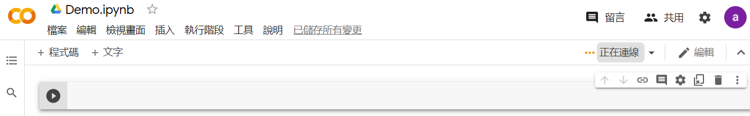
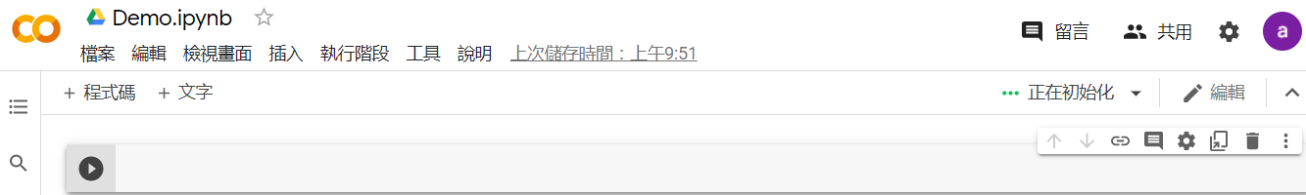
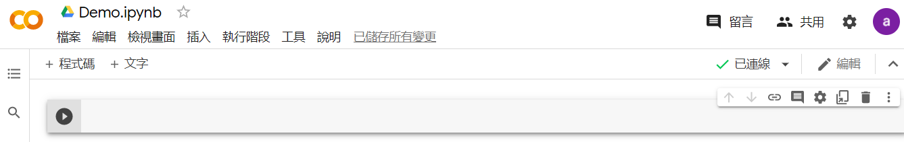
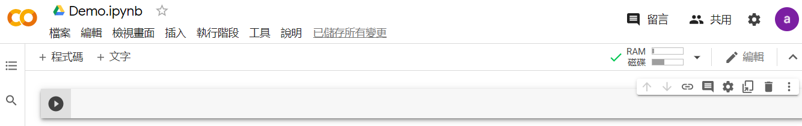

Slide 29
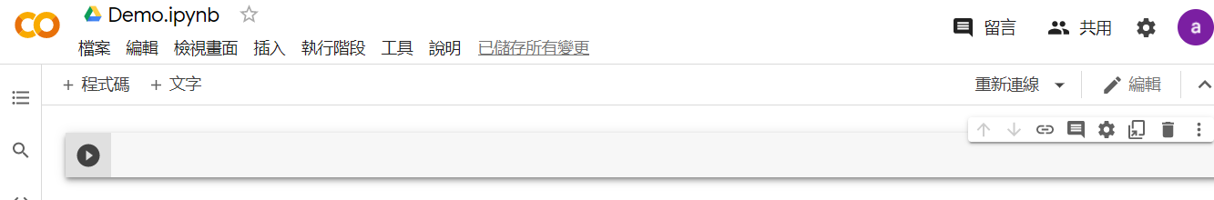
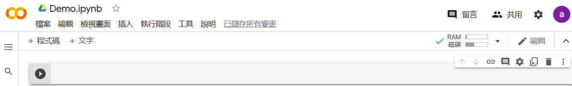

Slide 30
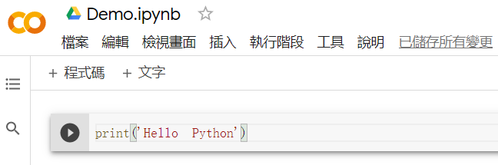
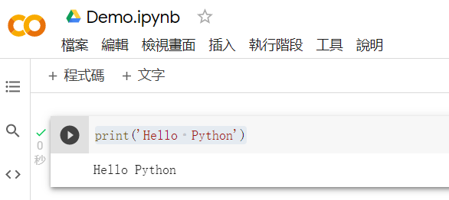
執行完Python指令

Slide 31
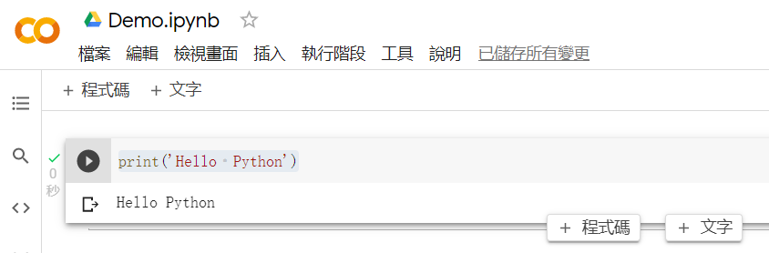
新增程式碼區塊功能
新增程式碼區塊功能

Slide 32
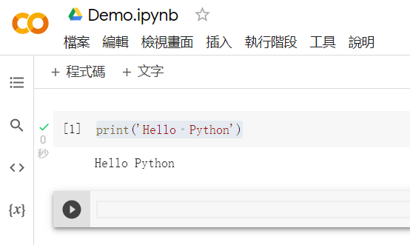
執行順序編號
第二個程式碼區塊

Slide 33
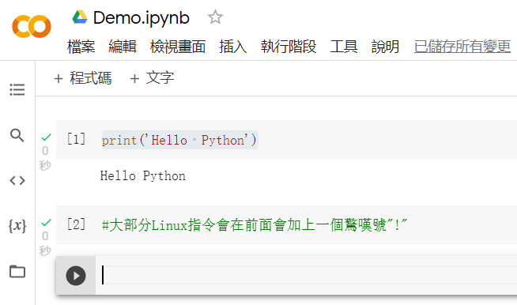

Slide 34
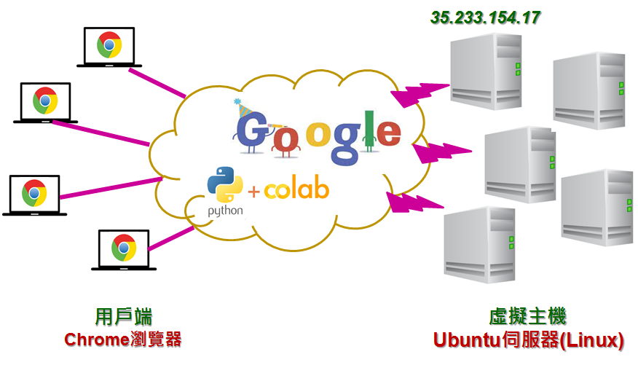
Ubuntu
ㄨˇ ㄅㄨㄥˋ ㄊㄨ˙

Slide 35
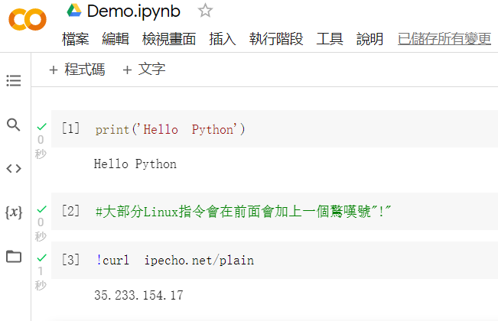
程式區塊
執行結果

Slide 36
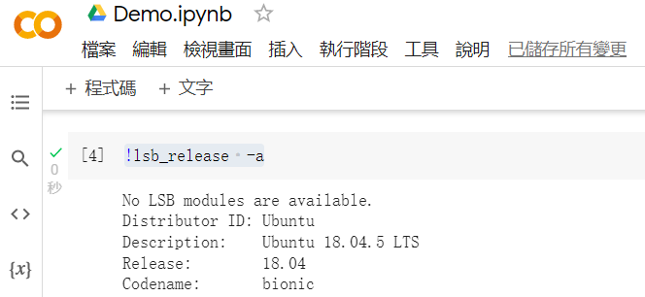

Slide 37
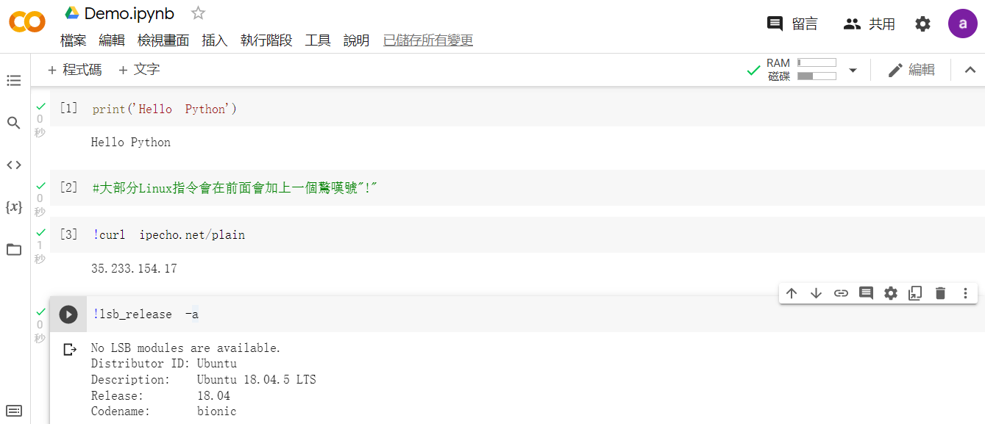
程式碼區塊
雲端虛擬主機資源分配
執行結果
常用工具列

Slide 38
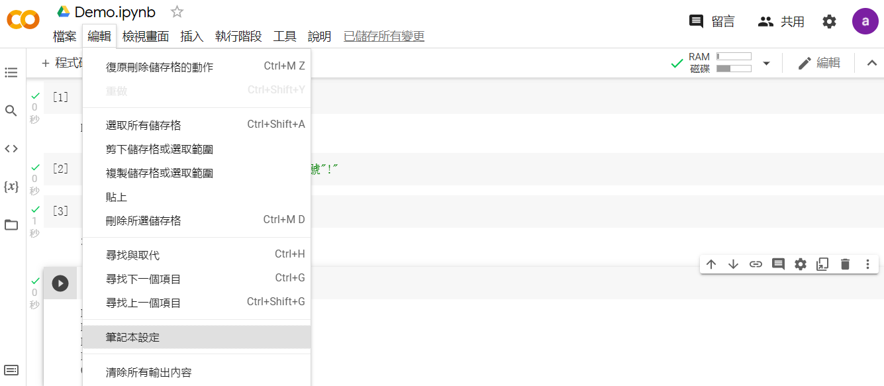

Slide 39
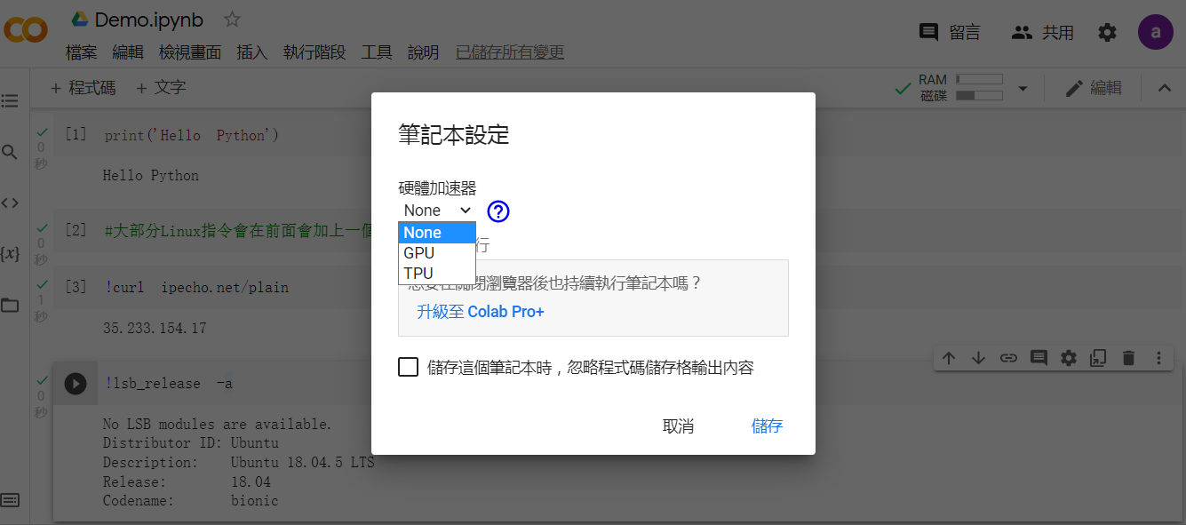

Slide 40
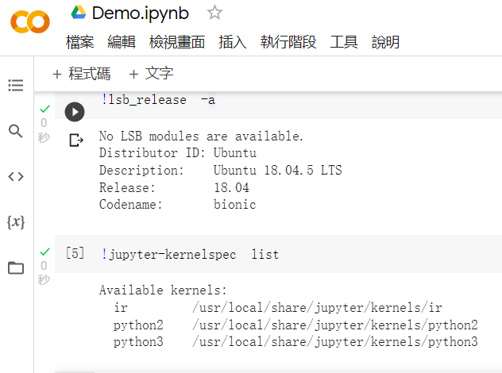
可以使用的內核清單

Slide 41
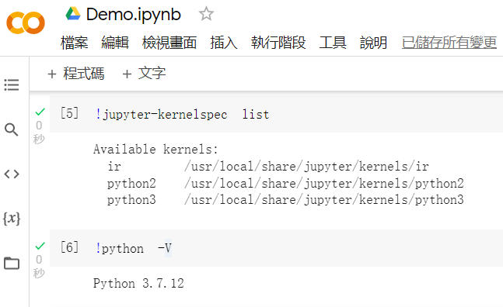
Python 3.7.12

Slide 42
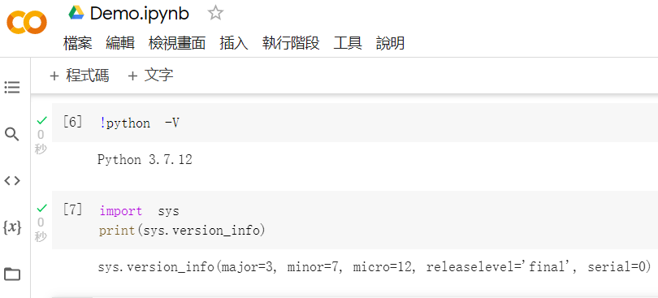

Slide 43
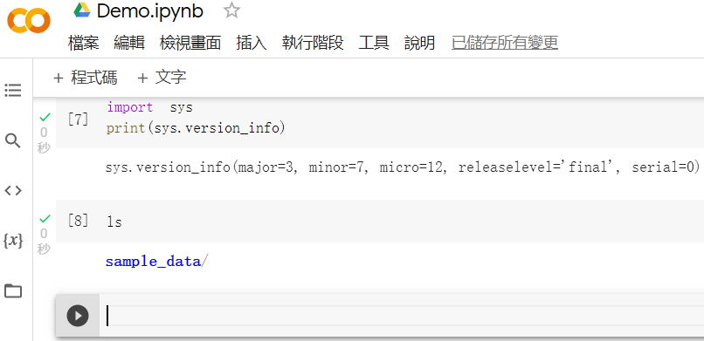

Slide 44
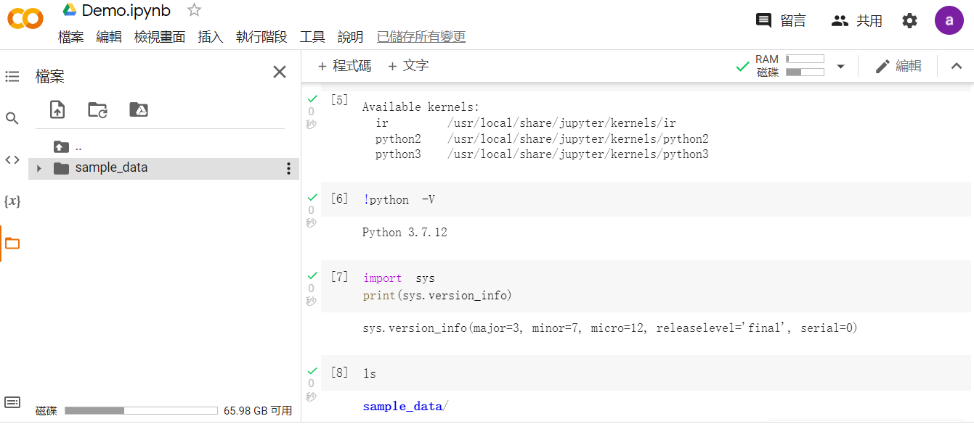

Slide 45
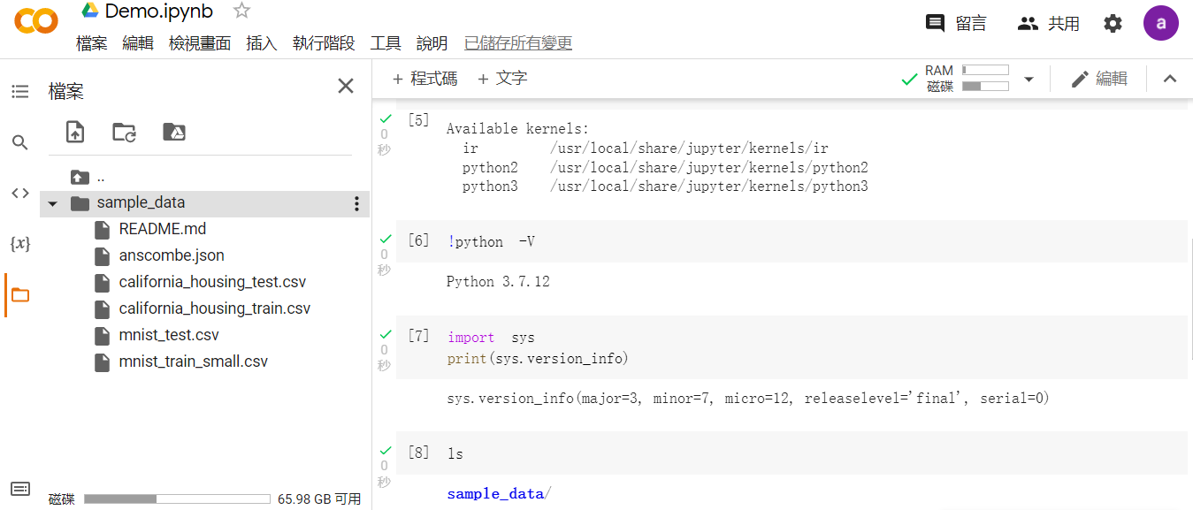

Slide 46
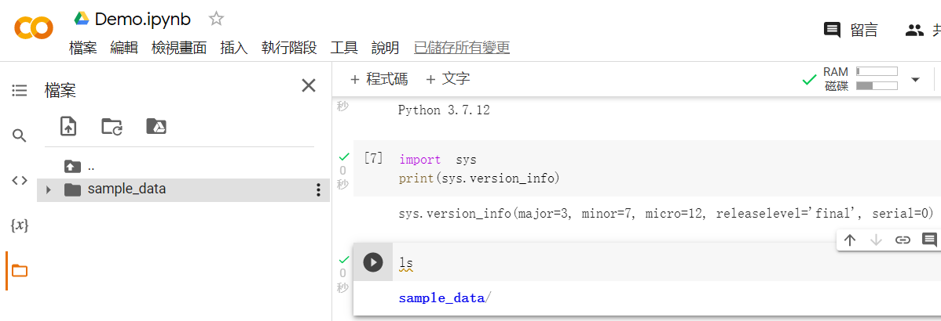

Slide 48
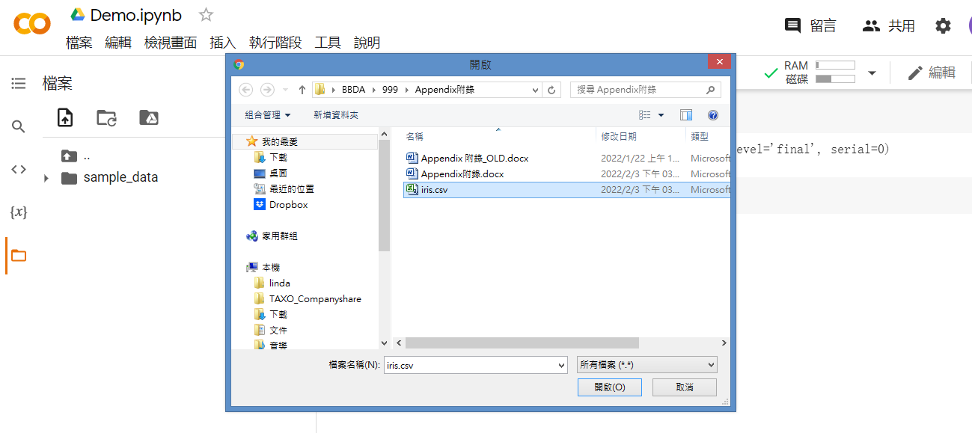

Slide 49
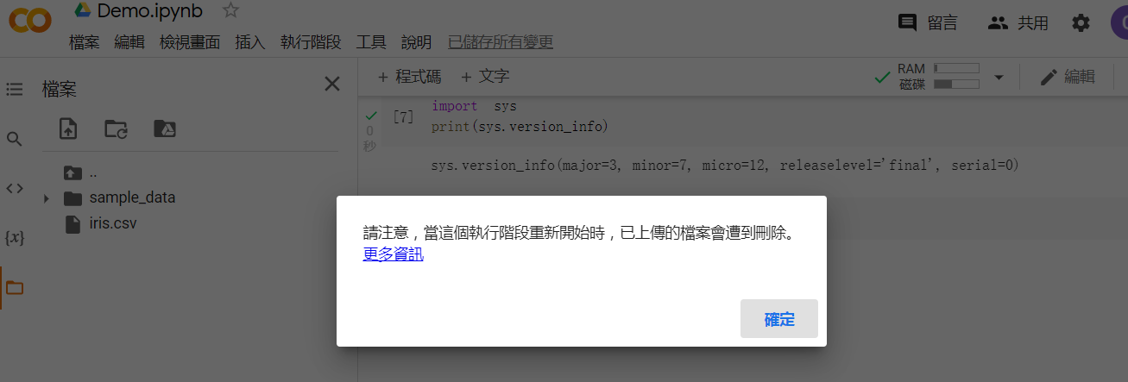
看一遍

Slide 50
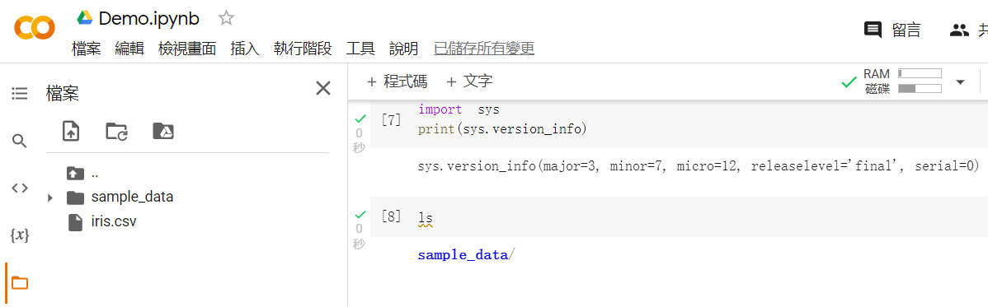

Slide 51
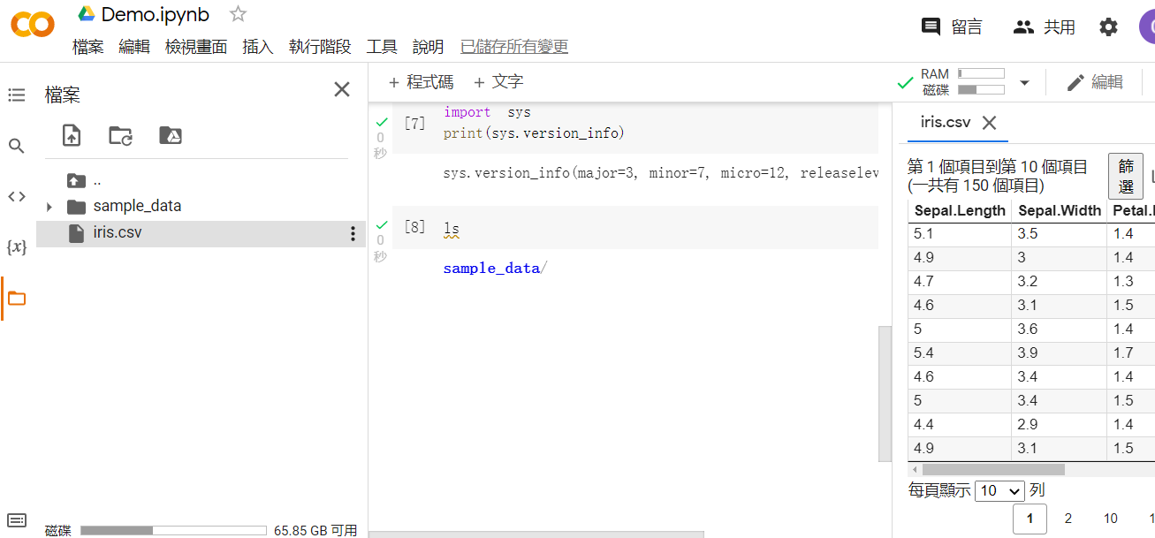
滑鼠連續點兩下

Slide 52
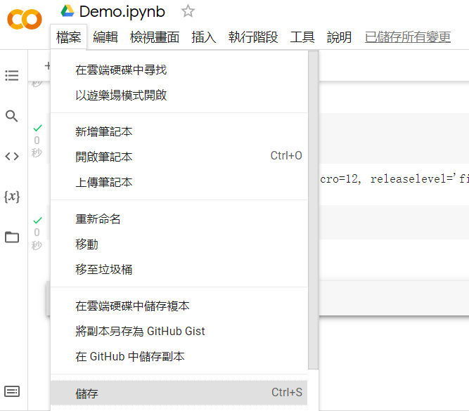

Slide 53


Slide 54
Colab installation & usage
Important Python packages
Flow control：if and for loop

Slide 55


Slide 56
About sklearn
Scikit-learn, https://en.wikipedia.org/wiki/Scikit-learn: It contains
1. Data preprocessing
2. Supervised learning
Classification
Regression analysis
3. Unsupervised learning
Clustering
Dimensionality reduction
4. Model selection

Slide 57

類別預測
數值預測
集群分析
維度縮減

Slide 58
Colab installation & usage
Important Python packages
Flow control：if statements & For (or DO) loop

Slide 59

if condition:
expressions
BMI = float(input(“Please input your BMI value:"))
if BMI>=35:
print(“Obese!”)

Slide 60


Slide 61

if condition:
expressions_A for True condition
else:
expressions_B for False condition
temperature = float(input(“Please input you temperature(°C):"))
if temperature >= 37.5:
print(“Have a fever!!")
else:
print(“Normal~")

Slide 62


Slide 63

For loop
Syntax
for condition:
expressions
for <variable> in <sequence>:
expressions
中文解釋
for 變數 in 任何序列物件:
執行內容

Slide 64


Slide 65


Slide 66


Slide 67


Slide 68


Slide 69


Slide 70
Q&A

